Slide 1
Prematurity
Prof Priyantha Perera
Faculty of Medicine Ragama
June 2016

Slide 2
Introduction
Worldwide 15 million babies are born preterm
Preterm birth complications are the leading cause of death among children under 5 years of age
¾ could be saved with current, cost-effective interventions.
Rate of preterm birth: 5% to 18% (SL about 15%)

Slide 3
Definitions
Gestational age
<37 weeks completed
Extremely preterm
<28 weeks gestation
Very preterm
28+0 weeks to 31+6 weeks gestation
Moderate to late preterm
32+0 weeks a to 36+6 weeks gestation

Slide 4
Causes of preterm delivery

Slide 5
Prevention of preterm birth and its complications
Prolong pregnancy as long as is safely possible
Tocolytics, cervical circlage, progesterone
Magnesium sulphate
Antenatal steroids
Delivery of high risk infants in tertiary centre
NICU costs

Slide 6
Complications of prematurity
Hypothermia
Hypoglycaemia
Respiratory distress syndrome Immediate
Infections
Necrotising enterocolitis (NEC)
Feed intolerance
Apnoea of prematurity
Jaundice of prematurity
Aneamia
Osteopaenia of prematurity intermediate
Retinopathy of prematurity
Intraventricular haemorrhages
Cerebral palsy
Other neurological complications depending on long
problems encountered during neonatal period

Slide 7
Hypothermia
Reduced Surface Area /volume ratio
Reduced Subcutaneous fat
Reduced Brown fat ( esp SGA )
Reduced energy stores
Exposure
Wet

Slide 8
Heat loss
Conduction ( contact c. cold surface)
Convection ( air currents )
Radiation ( radiating to cooler surface )
Evaporation ( baby wet, also transepidermal)

Slide 9
Heat Loss : Management
Pre-warm radiant heater
Minimise exposure time-don’t mess around
Dry
Use plastic wrap/oven bag
Change drapes to dry drapes
Assess need for incubator care
Use transport incubator
Maintain neutral thermal range
Use incubator; open only when necessary
Minimum handling
If ELBW : use humidification in incubator

Slide 10
Hypothermia
Plastic bags at delivery
Humidity in incubators
Kangaroo mother care (details in SGA lecture)
Warm environment
Use of radiant warmers during procedures
Clothing

Slide 11
Bacterial infection
Predisposed by
PROM
Premature immune response
Immature skin
Devices ( IV etc )
Immature immune system
Polypharmacy /unnecessary broad spectrum antibiotics- resistant organisms

Slide 12
Respiratory Distress
Surfactant deficient lung disease
– most common in < 32 weeks
- hyaline membrane disease
Other causes
TTN “wet lung”
Pneumonia
Congenital malformation ( eg CDH, OA )
Pneumothorax
Pulmonary hypoplasia if PROM

Slide 13
Respiratory Distress
Tachypnoea
Intercostal recession
Sternal recession
Paradoxical respiratory movement
GRUNT
Oxygen requirement

Slide 14
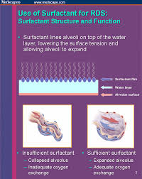
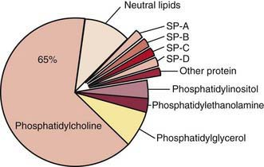
Respiratory Distress Syndrome
Surfactant deficiency
Increases alveolar surface tension
Collapses lung alveoli

Slide 15
Resp Distress: Management
A.B.C.
Minimal handling
Minimal FiO₂ to achieve 90-94% saturation (Avoid nasal prong oxygen for preterm babies – unless for chronic lung disease)
Assess for infection – treat if indicated
IV fluids: Avoid glucose, electrolyte disturbance
Consider need for invasive monitoring
Decide need for particular ventilatory support

Slide 16
Resp. Distress : Management
CPAP – from time of birth
“Delivery room CPAP”
- avoid need for invasive ventilation
Ventilation - conventional - HFOV
Surfactant - as ‘rescue’ rather than ‘prophylactic’
NICU
( Inotropes )

Slide 17
Intraventricular Haemorrhage
Gestation related. Rare > 32/40
Most major IVH < 28/40
Bleeding from germinal matrix
Blood into ventricles
Venous obstruction may cause periventricular infarction
Seizure
Hydrocephalus
Cerebral palsy/ learning disability
Minor grades : risk of poor nerudevelopment low

Slide 18
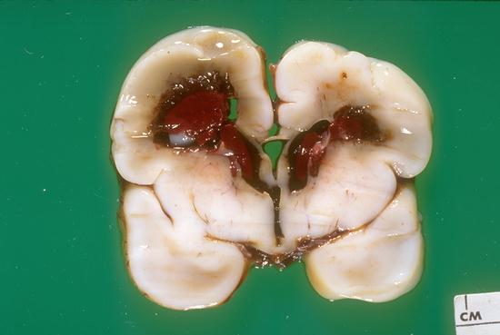

Slide 19
Feeding
Expressed breastmilk preferred
NEC incidence
EBM: EBM + Formula : Formula 1:3:6
Gut dysmotility
Necrotising enterocolitis
Inflammation of gut resulting in gut ischaemia and bacterial migration

Slide 20
Jaundice
Liver enzymes immature
Prolonged physiological jaundice
Due to blood brain barrier is less effective need treatment at a lower bilirubin level

Slide 21
Approach to small baby
Talk to parents antenatally. Give idea of what to expect. Find out any issues - liaison with Obstetric team
Preparation of resuscitation equipment
ABC
Minimal handling
Neutral thermal environment
Asses respiratory support needs: ? Vent ? CPAP ? Oxygen
Consider and cover infection
Nursery/incubator care preparation

Slide 22
Iatrogenic Complications of Prematurity
Pneumothorax
Bronchopulmonary Dysplasia
Subglottic stenosis
Retinopathy of prematurity
Feed intolerance/orally aversive behaviour
Nosocomial infection with resistant organisms
“IV burns”
anemia
Separation/Psychosocial

Slide 23
Parents
Shocked, chaotic, overwhelmed
Unwell, tired, in pain
Scared, disempowered
Noise
No privacy, crowding, other families, new social rules
Need to keep rest of life, family etc together

Slide 24
Parents
Need frank discussion of outcome and choices
Inevitably need repeated discussions
Look for self – blame, anger. Deal with it.
Need good orientation to nursery
Stable contact with 1-2 senior people

Slide 25
Outcome
< 22 weeks : minimal survival
23 weeks : 30%
24 weeks : 60%
28 weeks : 90%
30 weeks : 95%
Disability overall < 1000g
Severe ~8%
Moderate ~15%

Slide 26


Slide 27


